Slide 1
Donovan Elementary MCAS
Parent/Guardian Information Session
MCAS 2019
Presented by
Stacy Fitzroy

Slide 2
MCAS DATES @ The DONOVAN
ELA
Math
Grade 3: 4/23 & 4/24
Grade 4: 4/30 & 5/1
Grade 5: 4/25 & 4/26
Grade 3: 5/2 & 5/8
Grade 4: 5/9 & 5/14
Grade 5: 5/3 & 5/7
Science
* Grade 5 Only: 5/15 &5/16

Slide 3
Preparing for a Successful Testing Day!!!
Get a good night’s sleep
Have a good breakfast
Dress comfortably
Get to school on time

Slide 4
Why are we testing?
Parents/Guardians Guide to State Testing….
http://www.doe.mass.edu/odl/e-learning/mcas-parentguide/content/index.html#/list/cj4jxenm900023d65lhuvtt8i?_k=qjgdcg

Slide 5
Massachusetts Comprehensive Assessment System Frequently Asked Questions (FAQs) about next-generation MCAS Results
Q: Why do we have a next-generation MCAS?
A: The new test is designed to have coherent, consistent high standards from one grade to the next and give a clear indication of students' readiness for the next grade level and college and career. The tests focus on students' critical thinking abilities, application of knowledge, and ability to make connections between reading and writing. Under the legacy MCAS, many students would pass MCAS only to arrive at college and find they needed remedial courses. The next-generation MCAS is designed to indicate where students are academically while there is still time to get them back on track.
Q: How do the new achievement levels compare to the legacy MCAS achievement levels?
A: The MCAS legacy achievement levels (Warning/Failing, Needs Improvement, Proficient and Advanced) were established as new tests were introduced between 1998 and 2006. Each time a new test was introduced, a new panel of educators was selected to set standards with new members and sometimes different methods. As a result, the legacy standards varied widely from grade to grade in their definitions of Proficient. Because the next-generation MCAS program is rolling out with grades 3–8 together and grade 10 planned for 2019, the educators who set the new standards had the opportunity to ensure that the definition of "Meeting Expectations" is similar from grade to grade.
In general, the new standards for Meeting Expectations are at least as rigorous as the legacy standards for Proficiency. In grades and subjects where proficiency rates were very high under the legacy MCAS (like grade 8 ELA, where 80 percent of students were proficient or above in 2015), the new standards are much more challenging. In grades where legacy proficiency rates were lower (like grade 4 ELA, where 53 percent were proficient or above in 2015), the next-generation achievement levels are similar.
The new Meeting Expectations standards are designed to signal when a child is ready to succeed academically in the grade they are moving into. Eventually, this translates into college and career readiness. Right now, approximately 50 percent of Massachusetts's high school graduates complete college with either an associate's or bachelor's degree within six years after leaving high school. The next-generation MCAS is designed to help students know where they stand while they still have time to catch up. Waiting until they place into remedial courses in college is too late.

Slide 6
Q & A Con’t…
Q: Should I be worried about my child's score?
A: If a student scored in the "Not Meeting Expectations" category, parents should speak with their child's teacher or teachers about what needs to happen to bring the student up to speed in that subject. It can be hard to hear that a student is not where he or she hoped to be in their academic work, but the first step to mapping out the right supports is having an objective indication of where the student is now.
Similarly, educators and parents of students who scored in the "Partially Meeting Expectations" range should consider whether their students need additional academic help.
In all cases, families should remember that the MCAS is only one indicator of student achievement and that students in grades 3–8 do not face any negative consequences as the result of their scores.
Q: How should I use the MCAS results?
A: Parents can speak with their child's teacher if they have any concerns. Educators, using all of the interpretive materials available, including released items and item descriptions, can identify areas where students may need additional support or where a school's curriculum might not be aligned to the state learning standards.
Q: Will the new achievement levels be used for all grade and content area assessments?
A: Not yet. In spring 2019, assessments in grades 3–8 and 10 in English language arts (ELA) and mathematics and grades 5 & 8 science and technology/engineering (STE) are next-generation MCAS. Those will be reported using the next-generation achievement levels. The other remaining assessment, high school STE, will be reported using legacy achievement levels until it transitions to next-generation.
Q: Why do the next-generation MCAS scores on the 3–8 ELA and mathematics tests look different than the legacy MCAS scores?
A: The next-generation MCAS uses a scale of 440 to 560 and should not be directly compared to the legacy MCAS, which used a scale of 200–280.

Slide 7
Test Designs
ELA Test Design Grades 3-8
Math Test Design Grades 3-8
http://www.doe.mass.edu/mcas/tdd/ela.html?section=testdesign
Science/Technology Test Design Grade 5
http://www.doe.mass.edu/mcas/tdd/sci.html?section=testdesign
http://www.doe.mass.edu/mcas/tdd/math.html?section=testdesign

Slide 8
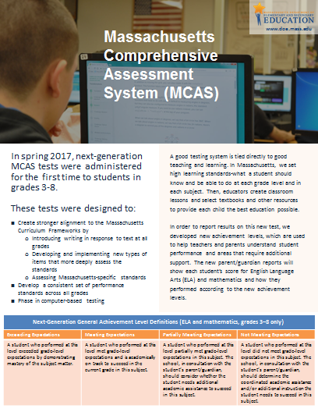
Achievement Levels

Slide 9
More Information
http://www.doe.mass.edu/mcas/parents/
Practice Tests 2019
http://mcas.pearsonsupport.com/student/practice-tests-ela/
http://mcas.pearsonsupport.com/student/practice-tests-math/
http://mcas.pearsonsupport.com/student/practice-tests-science/

